Slide 1
RIVER WATER QUALITY MONITORING
It is quality rather than quantity than matters.

Slide 2
abstract
Water is unique in its role as a life preserver. It is important to all members of a society. However, if one is looking for quality data in India to make data-driven decisions, one is lost. This is surprising given that there is a rich history of data collection in the country and looks forward to adopting real-time water sensing in a big way.
In River water system paper, we first explore issues around data management practices for water that have prevented their widespread dissemination and then, in response, propose a general data access and reuse framework which focuses on usage of water information for a purpose like irrigation, drinking or industrial need.

Slide 3
INTRODUCTION
There were lots of inventions, but at the same time were pollutions, global warming and so on are being formed, because of this there is no safe drinking water for the world’s pollution. Nowadays, water quality monitoring in real time faces challenges because of global warming limited water resources, growing population, etc. Hence there is need of developing better methodologies to monitor the water quality parameters in real time .
In this system we used several sensors for measuring the physical and chemical parameters of the water. The smart water quality systems consist of a NODE MCUcontroller. These water quality parameters pHs measure the hydrogen ions. It will show the water is acidic or alkaline7PH is the pure water.

Slide 4
HARDWARE software
Temperature sensor Aurdino IDE
Turbidity sensor MIT APP inventor
NODE MCU IBM Watson

Slide 5
Temperature sensor NODEMCU
RED WIRE - 3V3
BROWN WIRE - GND
YELLOW WIRE - D2(Data pin)

Slide 6
TURBIDITY SENSOR NODEMCU
RED WIRE - 3V3
BLUE WIRE - GND
YELLOW WIRE - A0(Data pin)

Slide 7
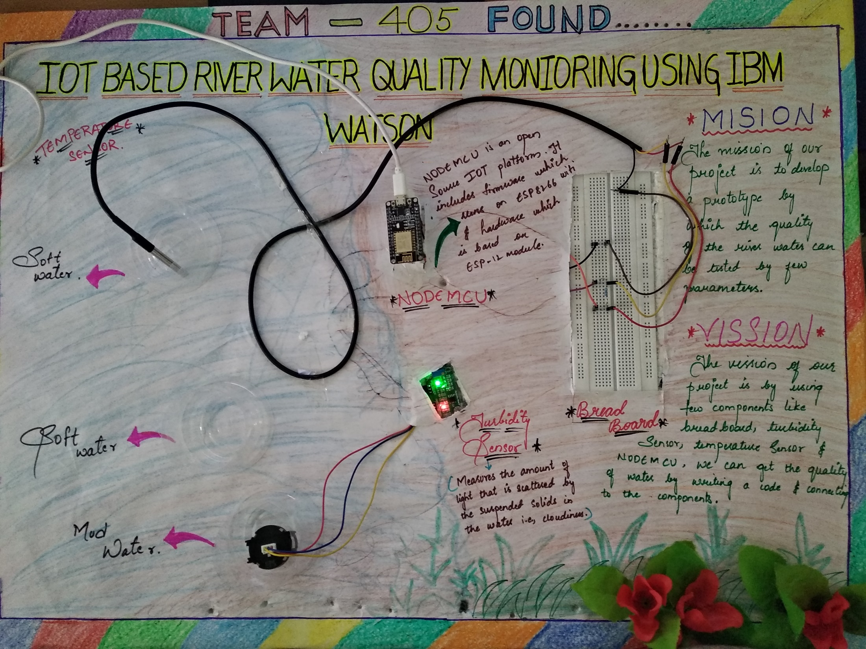

Slide 8
BLOCK DIAGRAM
TEMPERATURE SENSOR
IBM Cloud
NODE MCU
TURBIDITY SENSOR
User Mobile App
If Water quality is worst
Authority
Send Message

Slide 9
NODEMCU :-
Since NodeMCU is open source platform, their hardware design is open for edit/modify/build.NodeMCU Dev Kit/board consist of ESP8266 wifi enabled chip. The ESP8266 is a low-cost Wi-Fi chip developed by Espressif Systems with TCP/IP protocol. For more information about ESP8266, you can referESP8266 WiFi Module.

Slide 10
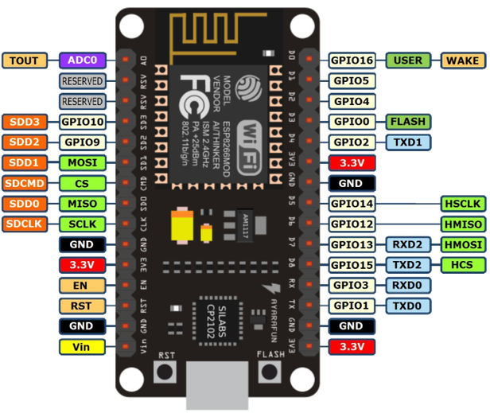

Slide 11
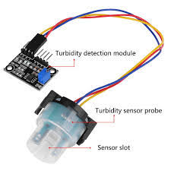
Turbidity sensor: Turbidity is a measure of the cloudiness of water. Turbidity has indicated the degree at which the water loses its transparency. It is considered as a good measure of the quality of water. Turbidity blocks out the light needed by submerged aquatic vegetation. It also can raise surface water temperatures above normal because suspended particles near the surface facilitate the absorption of heat from sunlight.

Slide 12
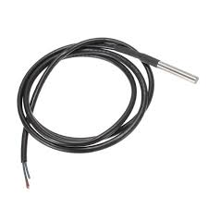
Temperature sensor: Water Temperature indicates how water is hot or cold. The range of DS18B20 temperature sensor is -55 to +125 °C. This temperature sensor is digital type which gives accurate reading.

Slide 13


Slide 14
CONCLUSION
Monitoring of Turbidity, Temperature of Water makes use of water detection sensor with unique advantage and existing GSM network. The system can monitor water quality automatically, and it is low in cost and does not require people on duty. So the water quality testing is likely to be more economical, convenient and fast. The system has good flexibility. Only by replacing the corresponding sensors and changing the relevant software programs, this system can be used to monitor other water quality parameters. The operation is simple. The system can be expanded to monitor hydrologic, air pollution, industrial and agricultural production and so on. It has widespread application and extension value.

Slide 15
THANK YOU
Presented by
TEAM :- 405 found

